Slide 1
Property Accounting
Physical Annual Inventory

Slide 2
Property Accounting Team
Adriana Mendiaz- Coronado- Supervisor of Financial Services
James Medina– Accountant II
Karen Diaz– Sr. Fiscal Services Tech

Slide 3
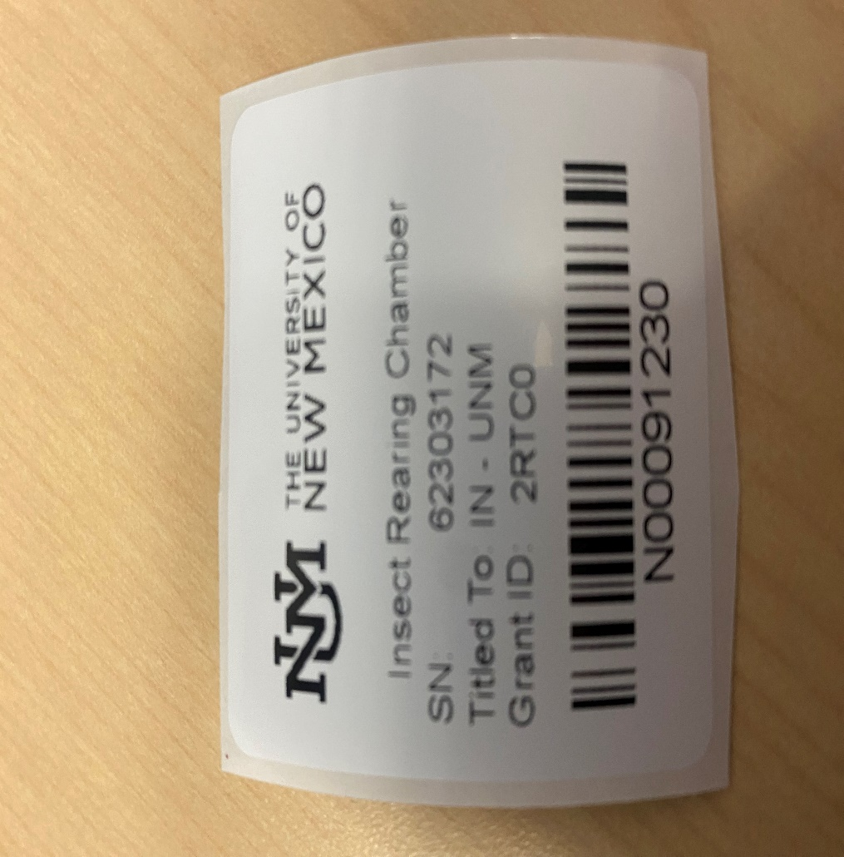
WHY A PHYSICAL INVENTORY?
Complies with state/federal regulations
Verifies existence and condition of equipment
Provides opportunity to make corrections
Ensures accuracy of UNM inventory records

Slide 4
WHAT’S ON YOUR INVENTORY?
Based on UNM Policy 7710: Property Management and Control For the purposes of this policy, inventoried property is defined, with one exception,by the following:
  The cost is greater than $5,000,
  The property is moveable and
  The property has a useful life of more than one (1) year and
  Drones are treated as inventoried property regardless of cost.
****The assets required for certification may vary each fiscal year. Please see next slide for details.****

Slide 5
Physical Annual Inventory TimeLine
Preparing for the Annual Inventory starts in December of the prior year and ends in April of the current year
Below is an example of an Inventory Schedule:
December 6 First Prenotification sent to all Inventory Contacts
December 14 Second Prenotification sent to all Inventory Contacts
January 2 Third Prenotification sent to all Inventory Contacts
January 8 Fourth Prenotification sent to all Inventory Contacts
January 18 Annual Inventory begins
April 1st Annual Inventory completion deadline

Slide 6
Annual Physical Inventory is no longer in “Waves”
Annual Inventory is not longer done in “waves” but is now done annually via electronic certification. All assets that meet the inventory requirements, that are in the Orgs assigned to Inventory Contacts will be a part of the inventory. IC’s and DDC’s are responsible for inventory and certified all assets in the one wave period.
For example:
  John Doe is the IC and Becky Blue is the DDC for Org codes 123A and 231A
  John Doe will be responsible to inventory All assets in these Orgs in the inventory timeline
  Both John and Becky are to certify all assets in these Orgs that will produce the annual certification provided in the annual audit

Slide 7
What Comes Before the Inventory?
Prenotifications- are to ensure the IC’s and DDC’s for each Org are accurate and updated before the inventory starts
These will be sent via Smartsheets in December of the prior year
  Example- FY24 Inventory starts in March 2024 – Prenotifications will be sent December 2023
All IC’s will receive an email with a link to the prenotification survey that must be completed as soon as possible

Slide 8
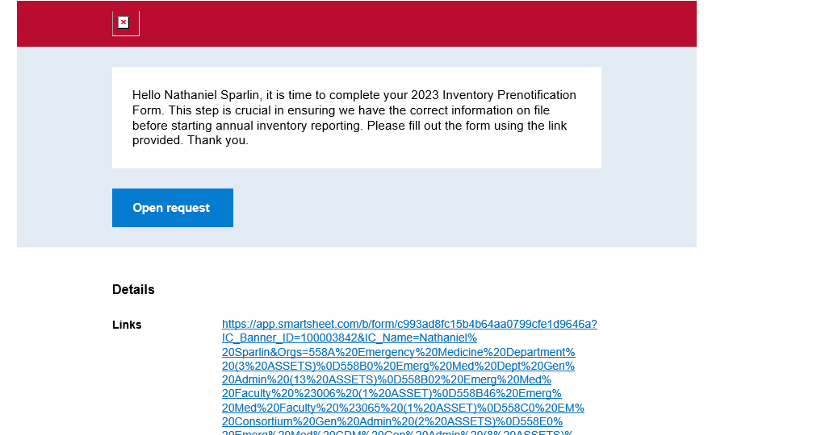
Smartsheets
Below is an example of the Prenotification Email Request
Please click on “Open Request” it will take you to the IC/DDC survey

Slide 9
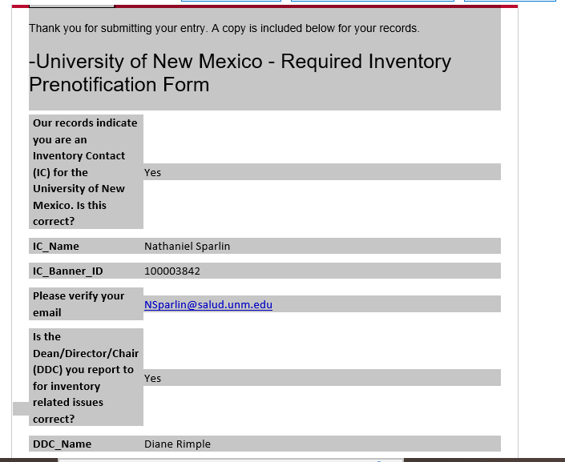
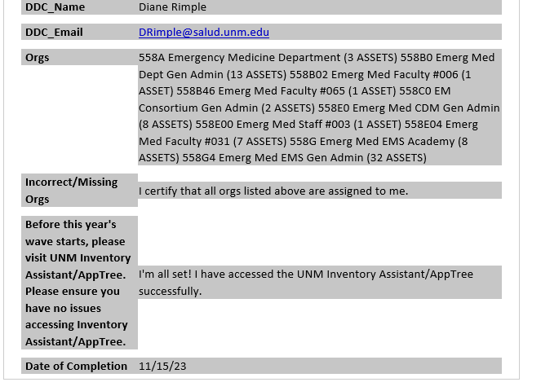
Smartsheets
Below is an example of the Prenotification IC/DDC Survey after completion

Slide 10
What do I have to do as the IC when I receive the Prenotifications Smartsheet Link?
Ensure that I have confirmed that the current listed IC and DDC (listed on the form) will still be the IC and DDC during the Annual Inventory
      *Now if at any point after the Prenotifications was submitted the IC or DDC needs to be updated it’s crucial that you let us know via email at UNMinventory@unm.edu.*
      Now, if you need to update the IC and/or DDC, please update them in the correct section. PLEASE DO NOT OVERRIDE OLD IC OR DDC. The Smartsheet has a certain location for the new IC/DDC.
      Once you have either confirmed or updated the IC and or DDC, you should be able to submit the form.
      Please note you will receive an Smartsheet Notification Email until you complete the form.
      It’s crucial that when completing the Prenotification in Smartsheet, you as the IC, complete it with accurate information.

Slide 11
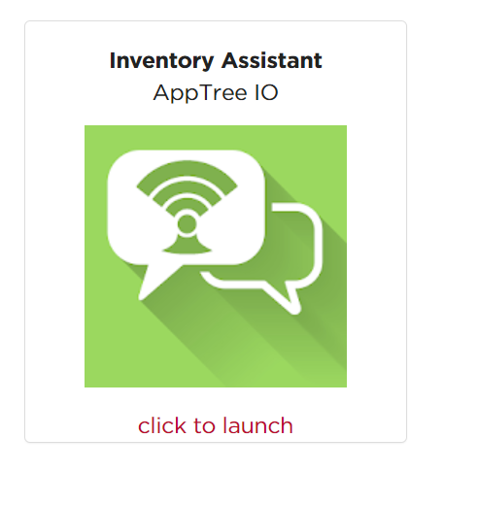
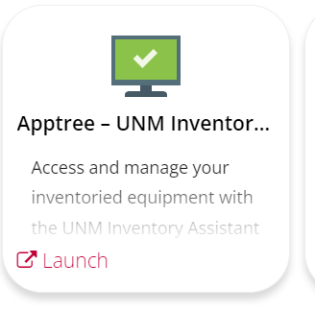
PHYSICAL INVENTORY “HOW TO”
Log in to UNM Apptree- SOS Log In
You can access several different ways – My UNM Page or the Property Accounting Website
  Link- https://propertyaccounting.unm.edu/inventory-assistant/inventory-assistant-support.html

Slide 12
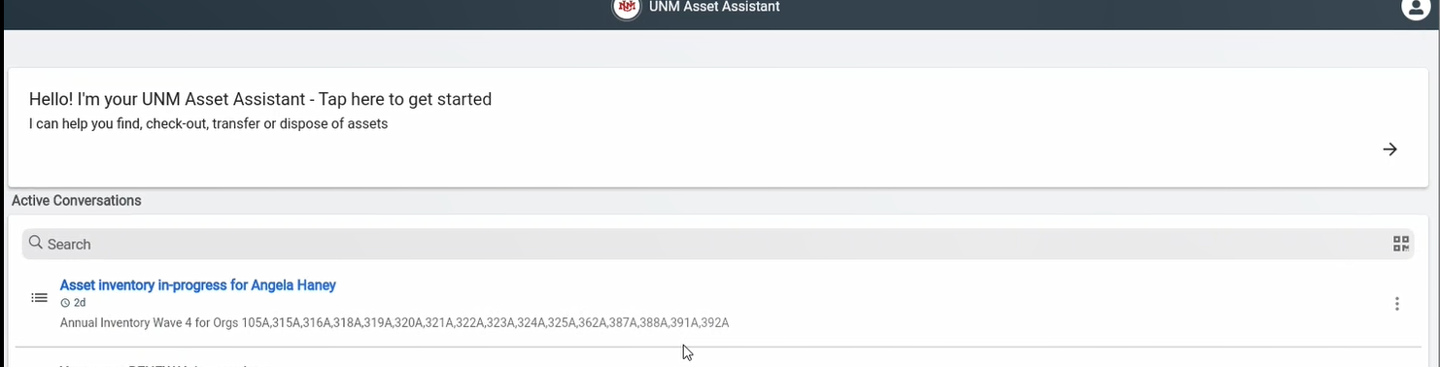
PHYSICAL INVENTORY “HOW TO”
Active Conversations- Holds your Asset Inventory in-progress- This is where you will find all your assets that need to be inventoried and certified.

Slide 13
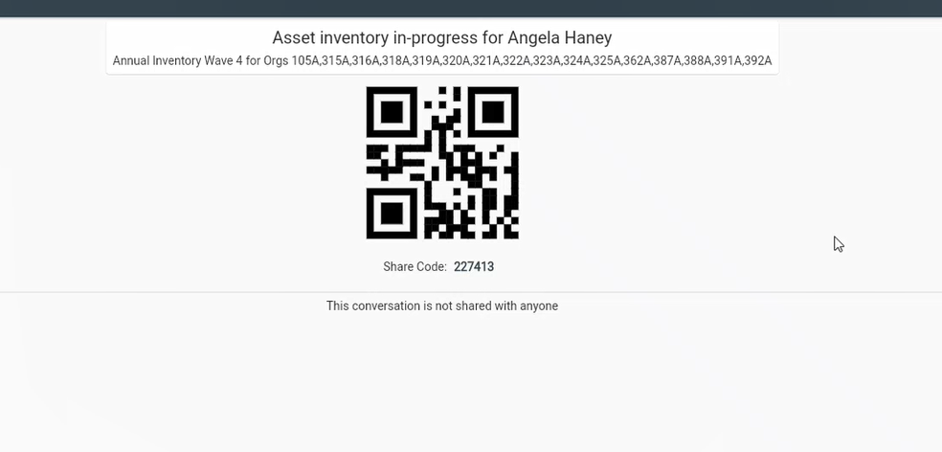
PHYSICAL INVENTORY “HOW TO”
Need help with your Annual Inventory? You can share your inventory with someone by clicking the 3 dots on the active conversation and selecting share. This will bring up the below code or URL that the person that you will share this with can then access your annual inventory as well. The person receiving the code can either scan this code or enter the code in there receive conversation in Apptree.

Slide 14
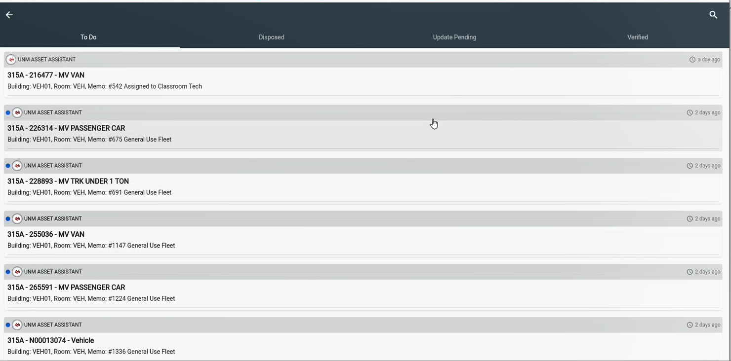
PHYSICAL INVENTORY “HOW TO”
Click on the conversation to access/open it
Once you open the conversation you’ll see 4 tabs, “to do”, “skipped”, “update pending”, and “verified”

Slide 15
PHYSICAL INVENTORY “HOW TO”
By clicking on the search icon, you can search your active conversations by ORG Code
      * This will help when looking for all your assets in one ORG

Slide 16
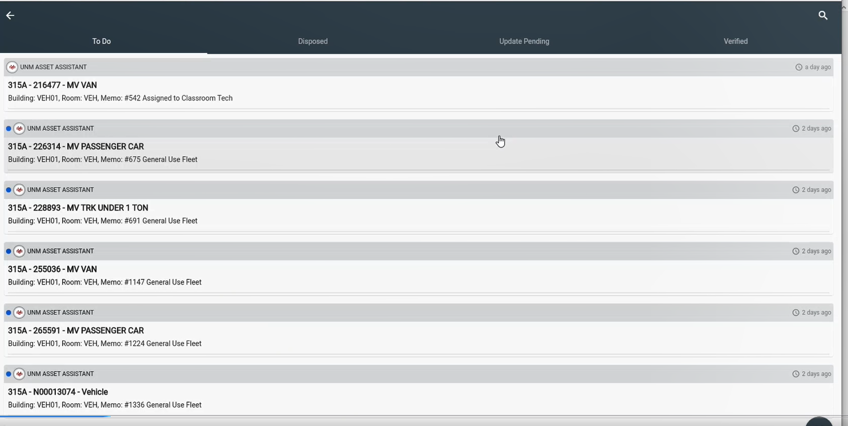
PHYSICAL INVENTORY “HOW TO”
You Inventory will start on your “to do” list. Here you will see all the assets for your FY24 inventory.
As you work through your “to do” list, assets that you update/change will go from your “to do” list to your “update pending” or “verified” tabs.
Example - If you update the building and room number on an asset, it will move from your “to do” list to the “update pending” tab, no further action needed by you.
Once you complete and certify your FY24 inventory, all the updates you made will be reflected.

Slide 17
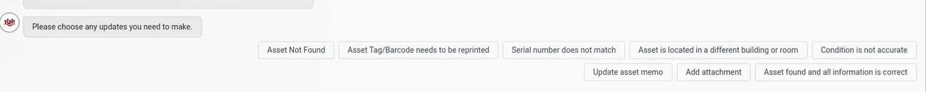
ASSET OPTIONS
Every asset listed on your inventory will have the below choices to update or modify
If no changes need to be made you would click “Asset found, and all information is correct” – this will move these assets to your verified folder and are pending to be certified

Slide 18
PHYSICAL INVENTORY “ Almost Done”
Once you have made all your edits or confirmed asset is found, you can move on to the next asset in your “to do” tab.
Once your “to do” tab is empty it means you’re almost complete with your FY24 inventory.
Once all your assets have completed update pending and verified- you will now receive a new “inventory conversation” in your active conversations, this conversation is your “verify and certify conversation”.
Open the conversation and follow the instructions to certify your FY24 inventory, both the IC and DDC will have to certify for you to be 100% complete with your FY24 inventory.

Slide 19
What do I do now that I am done inventoried all the assets?
Once you as the IC, have gone through each asset on your inventory and each asset has gone from your “ To do List” tab to either your “Update Pending” or Verified” tab, you as the IC will receive a “Certification Conversation”.
Certification Conversation- is where the IC and DDC are certify that all the inventory items have been reviewed and addressed one by one, and the accurate information has been submitted. This is the last approval for the Annual Inventory.
IC will certify 1st then Apptree will route the Certification Conversation to the DDC
Helpful Tips:
What if I already certified my inventory but still see me inventory conversation and it says “In Progress” ??
The IC will still see their “Annual Inventory” Conversation in their Active conversations until the DDC Certifies the inventory. This allows them to make any changes to the assets if needed, once the DDC reviews the inventory.

Slide 20
What do I do now that I am done inventoried all the assets?
Helpful Tips:
What if I already inventoried an item and it keeps giving me the option “re-inventory this asset”
If the IC opens an asset under their “Update Pending” or “Verified” Tab, they will see this option.
This option is there in case, the IC made a mistake, or they later find that something has changed. This option will be available until both the IC and DDC certify the Annual Inventory.

Slide 21
Definitions of Tabs for the Annual Inventory
Assets under your “To Do List” Tab- these are assets are pending to be inventoried.
Assets under your “Updated Pending” Tab- these are assets that IC made an update to the asset when they inventoried it
Assets under your “’Verified” Tab - means the IC made no changes and just selected the 'asset found and all information is correct' option.

Slide 22
When Is My Annual Inventory Done?
Once the IC and the DDC both open their certification conversation and certify your annual inventory for the fiscal year will be complete!
*** Please keep in mind both IC and DDC MUST certify to be at 100% completion and certified***

Slide 23
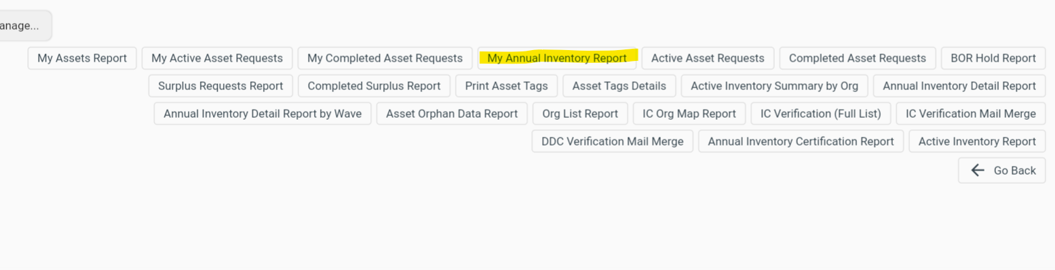
Can I download the Annual Inventory to Excel?
Yes! You can view all your assets on your Annual Inventory by downloading your “Annual Inventory Report” in your “Report Section” of Apptree. This will show you all your inventoried items in a list form in excel.

Slide 24
What if there is an asset that was supposed to be transferred but still on my inventory?
      There is an asset on your inventory that should have been transferred to another ORG, what do I do?
      1. Yes, your ORG is still responsible for inventory the asset since it was not transferred prior to the Inventory starting.
        a. You are still responsible for that asset until it’s off your Inventory.
        2. Please Inventory the asset, update the condition, location etc.
        3. Once you have completed, and certified your Annual Inventory, then you can submit an Internal Transfer in Apptree. Please note, your DDC will need to approve it then the receiving ORGs IC and DDC will need to approve as well for the internal transfer to be completed.

Slide 25
What do I do if I cannot locate an asset?
      It’s crucial that you look for each single assets individually and ensure that your department still has the asset, and you know where it’s at physically
      If after several attempts at locating an asset, it cannot be located you will have to mark the asset as “Asset Not Found”, this will mark the asset as not found in the inventory.
      That will also trigger a “Request to Delete Asset” Request after you have completed and certified your Annual Inventory. You must complete and submit the RDA as soon as possible to ensure the asset that was not found is removed from the inventory. (please see next slide for RDA information)
      If for some reason, after you completed your Annual Inventory, you locate the asset, please immediately contact UNM Property Accounting via email @ unminventory@unm.edu to ensure the asset gets back onto the inventory.

Slide 26
REQUEST FOR DELETION OF ASSETS (RDA) - Apptree
Submit RDA/Surplus request via Apptree
  List the asset tag number
  Please indicate the appropriate disposal codes- For Assets Not Found During the inventory please use “Department Adjustment”
    The below will be pull from the asset record
      The acquisition date, adjusted cost, and net book value
      Serial number and equipment description
      Title to, ORG Code, IC and DDC and Index
An explanatory memo must be attached to the RDA/Surplus request
If asset was stolen/missing- please submit a police report as well

Slide 27
RDA- Disposal Codes
Theft of Property – include police report
Un-located after exhaustive search – include explanatory memo
  Loaned Equipment – must obtain approval from agency for disposition
Returned toVendor/Trading-In – include exchange/return or purchasing documents
Cannibalization of Equipment – include explanatory memo
Other – include explanatory memo
Destroyed/Discarded/Disposed of by off-site employee – include explanatory memo and supporting documentation
Returned toAgency – includeAgency’s receipt or acknowledgement letter
Sent to Surplus Property Dept. and cannot locate documentation – include explanatory memo
Taken by former employee for grant-related work – include explanatory memo and transfer to another entity documents

Slide 28
Helpful Resource and Information

Slide 29
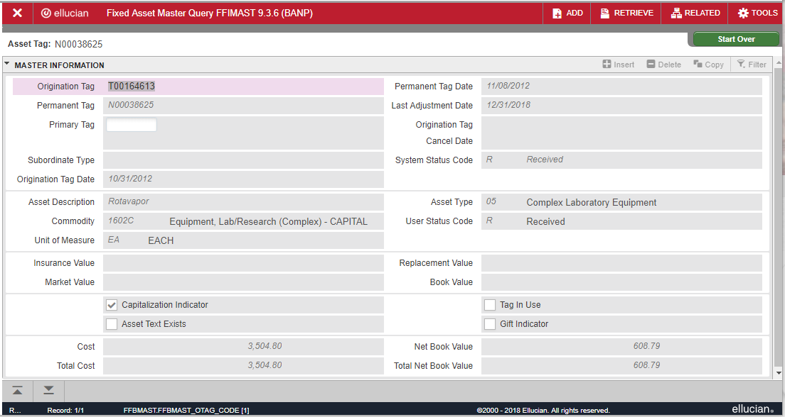
BANNER FORM – FFIMAST- Asset Information
Additional Information available:
  System Status Code
  Initial Cost
  Acquisition Method
  Disposal Method
  Procurement Information
  Grant number
  Accounting String for initial transaction

Slide 30
EQUIPMENT LOCATION- Why?
The location of each inventoried asset is required in the university inventory records. Current location records must be maintained so that any item can be located for inspection or inventory purposes within a reasonable time.
  Policy 7710: Property Management and Control - 3.3. Location and Security of Property
  Federal Acquisition Regulation 52.245-1(f)(iii)(A)
Please update the location of your assets at time of inventory
                Please update room, building of each asset in Apptree
If your inventory shows the following in the Room # column, provide the current location of the asset:
  CHK – Provide the employee’s office location or his/her supervisor’s
  VEH – Provide the building number where the vehicle resides
  OFF – Provide the physical location in memo field
  NEW – Provide the building and room number

Slide 31
BUILDING AND ROOM NUMBERS
Building and room numbers provided must match Space Database (FAMIS) nomenclature
FAMIS Portal Link: https://famisportal.unm.edu/famis/famis.asp
Space Management Support contact:
Space Management • 277-3800 • space@unm.edu
For more details refer to Space Management Inventory Control presentation

Slide 32
MAKING ADJUSTMENTS TO ASSETS
All Adjustment are done Apptree-
  Employee Equipment Checkouts
  Request for Deletion of Assets Form (RDA)
  Except;
  Transfer of Equipment to Another Entity Form and Memo
  Loaned/Donated Equipment Outgoing/Incoming
  Please email us at unmiventory@unm.edu for these forms

Slide 33
EQUIPMENT CHECKOUTS
Administrative Policies and Procedures Manual - Policy 7730:Taking University Property Off Campus: University property taken off campus must be used only for University business. The property must be returned to its campus location as soon as the off campus work is completed.
Who can check out equipment?
  In the performance of job duties, faculty or staff members may need to use University property at their homes or at another off campus location.
  Emeriti faculty are entitled to full computer privileges under Faculty Handbook Policy C305, which may include checking out computers for use off campus.
The employee is responsible for the security of the property and its appropriate use and maintenance.
If property is taken off campus for a period of more than one year, please ensure that the check out in Apptree is still valid.

Slide 34
CHECKING OUT EQUIPMENT- APPTREE
Please submit a check out request in Apptree before taking University property off campus.
Please note the checkout will be good for a year and it will renew every year.
Check-ins request after property is done being used off campus are required to be submitted via Apptree
Asset Checkout | UNM property may be taken off campus for business purposes. The checkout process registers who is responsible for the security of the property and its appropriate use and maintenance.

Slide 35
EXPORT CONTROLS
Are your faculty and staff traveling internationally and planning on taking University owned equipment with them?
All UNM travelers who intend to take equipment or software abroad should check the with the UNM or HCS Office of Export Controls to ensure that they are in compliance with Federal regulations prior to travel abroad.
Travelers should also be aware of the list of countries that have been sanctioned by the U.S. Government.Travel to these countries may have restrictions or could require an export license.
For current information:
isd.unm.edu/export-control/export-control-guidance.html
UNM Office of Export Control Contact:
  Email: export@unm.edu
  (505) 277-2968
HSC Office of Export Control Contact:
  Email: hscexport@salud.unm.edu
  272-5993

Slide 36
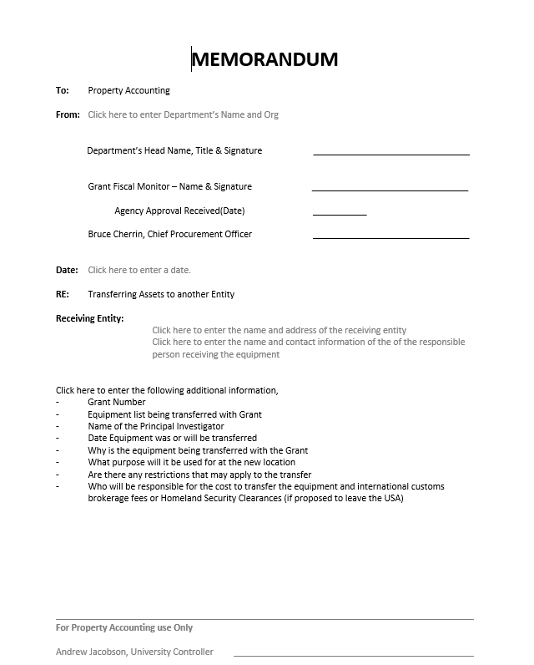
TRANSFERS TO/FROM ANOTHER ENTITY
Policy 7710: Property Management and Control - 5.2.Transfer of Assets to Another Institution
Equipment purchased with funds from contracts and grants administered by the University legally belong to the University of New Mexico.
If a principal investigator transfers to another institution, in general, research grants will transfer with the principal investigator.
Contracts and grants for public service or training projects will usually remain at the University.
Guidelines within the contract or grant will specify the procedure to follow if the assets are to transfer with the grant.
Any equipment not officially transferred with the grant remains with the University.
Signatures of VP for Research, CPO, and University Controller will be obtained by Inventory Control after the form is submitted.
Please visit https://propertyaccounting.unm.edu/forms/inventory-forms.html for more information on External Transfers

Slide 37
Donated Equipment
Equipment Donations to the University
Do you have a piece of equipment that was donated to the university that needs to be recorded? Property Accounting records all equipment donations, regardless of fair market value. Please complete the Donation Smartsheet Forms using the link below. Be sure to submit both required forms within the Equipment Donation Smartsheet.
https://app.smartsheet.com/b/form/0d96ea5276c44bb0bb0c40f6d03043f5
Please visit https://propertyaccounting.unm.edu/forms/inventory-forms.html for more information on any inventory forms.

Slide 38
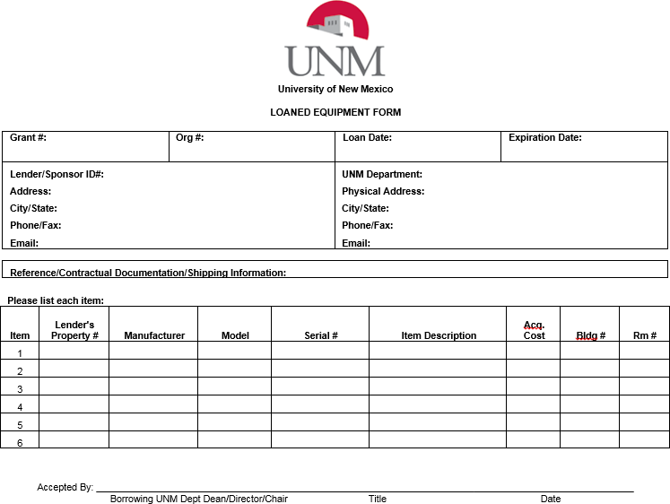

INCOMING LOANED EQUIPMENT
Purchased with Agency Funds or Physically furnished
  Title is retained by agency
  Regardless of cost, all government property will be tracked
  Blue tags for U.S. Government equipment
  Green tags for Non-U.S. Governmentequipment
  Account code# 9040 (only for purchases)
Fill out form completely (physically furnished only)
Include the Grant # (if applicable),the Org #,the loan date,and the expiration date.
Include reference number for contract and shipping information (if applicable)
Include the description of the equipment: lender’s property number,manufacturer,model,serial number,and acquisition cost.
Include the location of the equipment
Receiving Department’s Chair, Dean or Director must sign the form

Slide 39

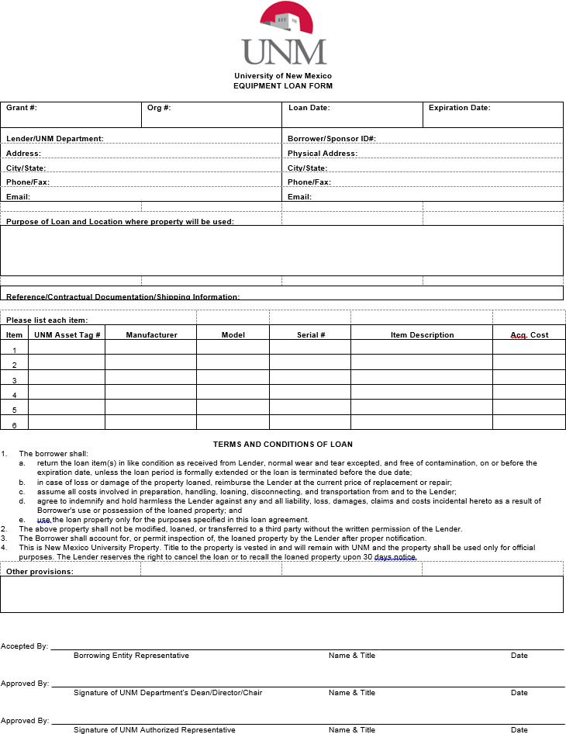
OUTGOING LOANED EQUIPMENT
Fill out form completely (physically furnished only)
  Include the Grant # (if applicable),the Org #,the loan date,and the expiration date.
  Include Lender/UNM Department contact information
  Include the name of the Borrower/Sponsor ID,Address and Contact Information
  Include reference number for contract and shipping information (if applicable)
  Document the purpose of the loan
  Include the description of the equipment: asset tag number, manufacturer,model,serial number,and adjusted cost.
Receiving Entity Representative, UNM Department’s Chair, Dean or Director, and Inventory Control must sign the form

Slide 40
SURPLUS PROPERTY
Surplus Property pickup requests are submitted via Apptree
        * requires at least a serial number
Contact Surplus for any questions
Please note capital equipment must be on Board of Regent Hold for 30 days
  Email: unmsurplus@unm.edu
  Phone: 277-2923

Slide 41
MYREPORTS - INVENTORY REPORT
Helpful Resource for Inventory Contacts!
In a continued effort to provide departments with more user friendly tools, we have an Inventory Report available in MyReports. This report allows departmental inventory contacts (and Department Heads) to access their inventory list for review of assets.
The report will include the option to run queries by Organization Code,TitleTo (ownership), Building number, and Grant ID. In addition, the report can be filtered by the Asset Status: “All”,“Active” or “Deleted”.
The FNRFAIC – Fixed Asset Inventory Control report can be found on the Finance tabin MyReports under the folder“FAll Campus Reports”.
To obtain access to MyReports, submit a BAR adding the role “Department General Inquiry” and include a note on the Business Reason that you “need access to MyReports to fulfill your responsibilities as the Inventory Contact for your department”.

Slide 42
RESOURCES:
The following forms and documents are available on our website:
  Guidelines andTutorials:
    Wave Presentation
    Account Code Definitions
    Account Code DecisionTree
    Capitalization Threshold Memo
    Guidelines for Adjusting Your Inventory
    Banner Tutorial
  Wave Schedule
Forms
Inventory Contact
Request for Deletion of Assets
Transfer to Another Entity Form and Memo
Incoming Loaned Equipment
Outgoing Loaned Equipment
Equipment/Computer Purchase
Fabrication Control Number Request
Contact us any time via email-
unminventory@unm.edu
https://propertyaccounting.unm.edu/

Slide 43
THANK YOU!

